Slide 2

React.js from Facebook
Hi I’m Mohamed Anas Ben Othman

Slide 3
What is React? & Basic intro to Components
React

Slide 4
React is a JavaScript library for building user interfaces. & it is used by leading brands namely Facebook, Instagram, WhatsApp, Airbnb, Uber, Netflix, Twitter, Pinterest, Reddit, Udemy, Wix, PayPal, Stripe and others
What’s React?

Slide 5
Developed and Maintained by Facebook, Instagram and a community of individual developers and corporations
Who is behind React?

Slide 6
Facebook, Instagram, WhatsApp, Airbnb, Uber, Netflix, Twitter, Pinterest, Reddit, Udemy, Wix, PayPal, Stripe and others
Who use React?

Slide 7
What’s inside the box?
React use JSX (JavaScript XML)
React has
Virtual DOM
React is
Component-based

Slide 8
JSX, or JavaScript XML
JSX is a JavaScript syntax developed by React, it make using HTML-like code inside JS possible.

Slide 9

Yes, we can create
a class in JavaScript
HTML inside JavaScript
class Greeting extends React.Component {
render() {
return <h1>Greetings, {this.props.to}</h1>;
}
}
--------------------------------------------------------------------------
<Greeting to="John" />
Using the Component, like a regular HTML tag

Slide 10
Components
React is component-based, it means that React encapsulates the user interface elements into “Components” for the facility of building complex user interfaces.

Slide 13
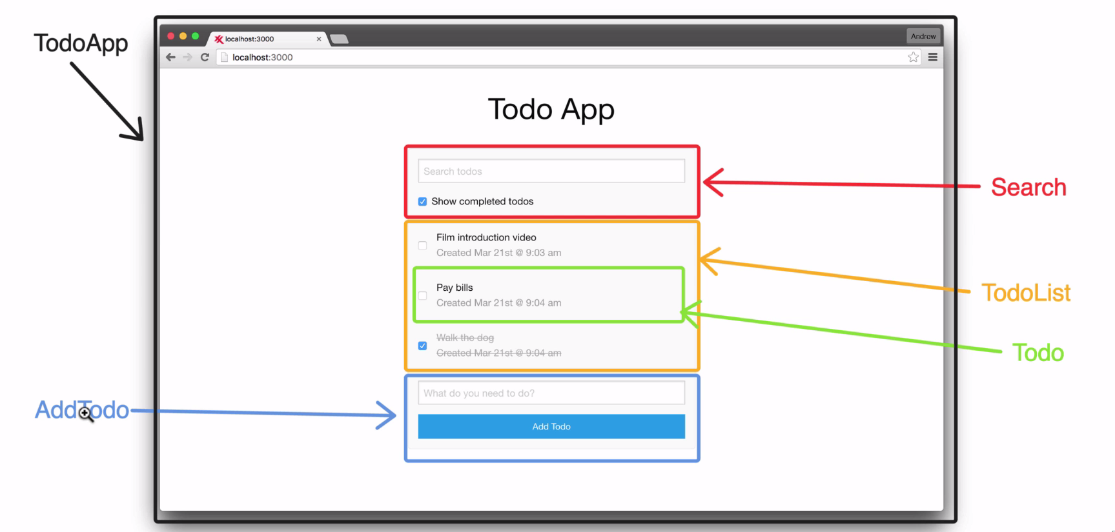

Slide 14
Everything is Component

Slide 15
Exercise

Slide 16
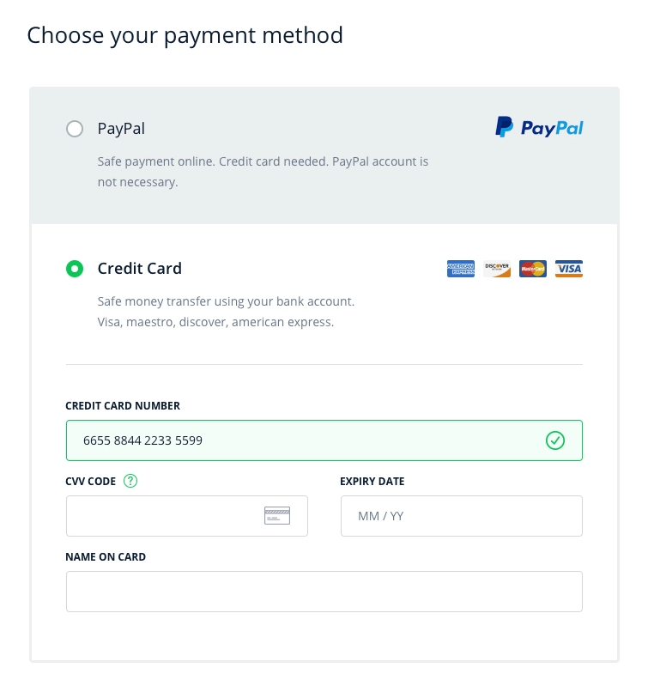

Slide 17
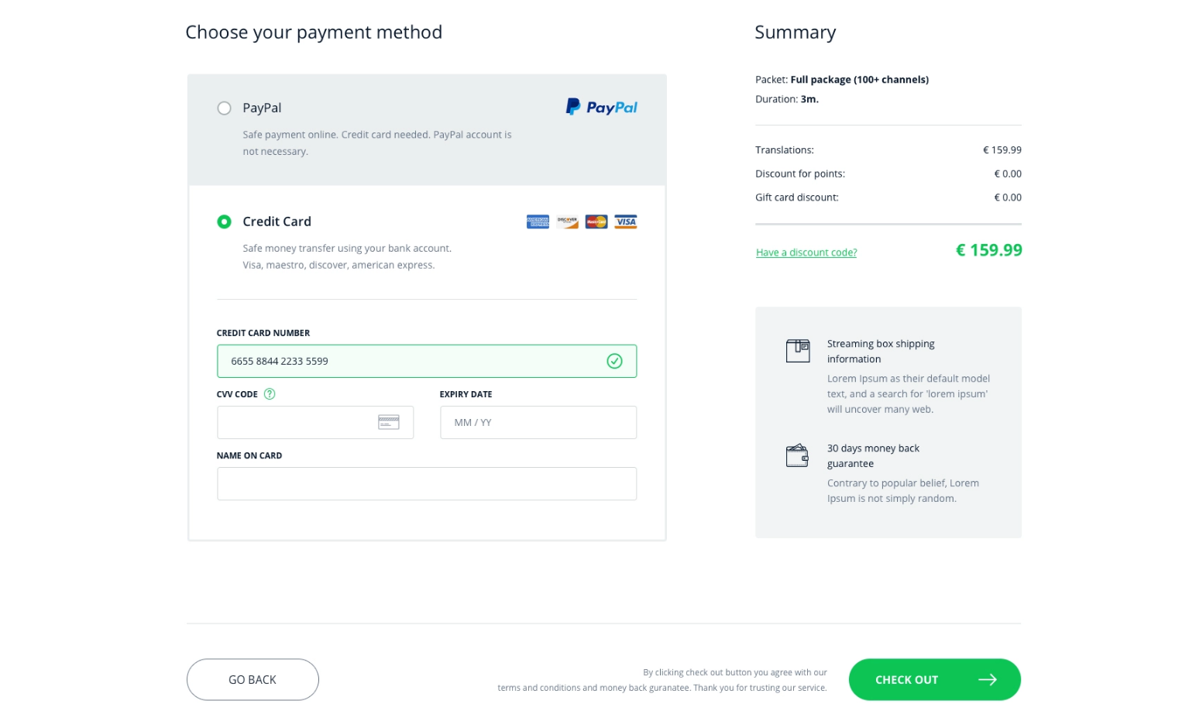

Slide 18
What is Virtual DOM? & Comparison of React DOM & The Real DOM
Virtual DOM

Slide 19
What’s DOM?
DOM is the abbreviation “Document Object Model”
The DOM is the representation of XML or HTML elements in a tree-structure, where each node of the tree represents an “Object”

Slide 20
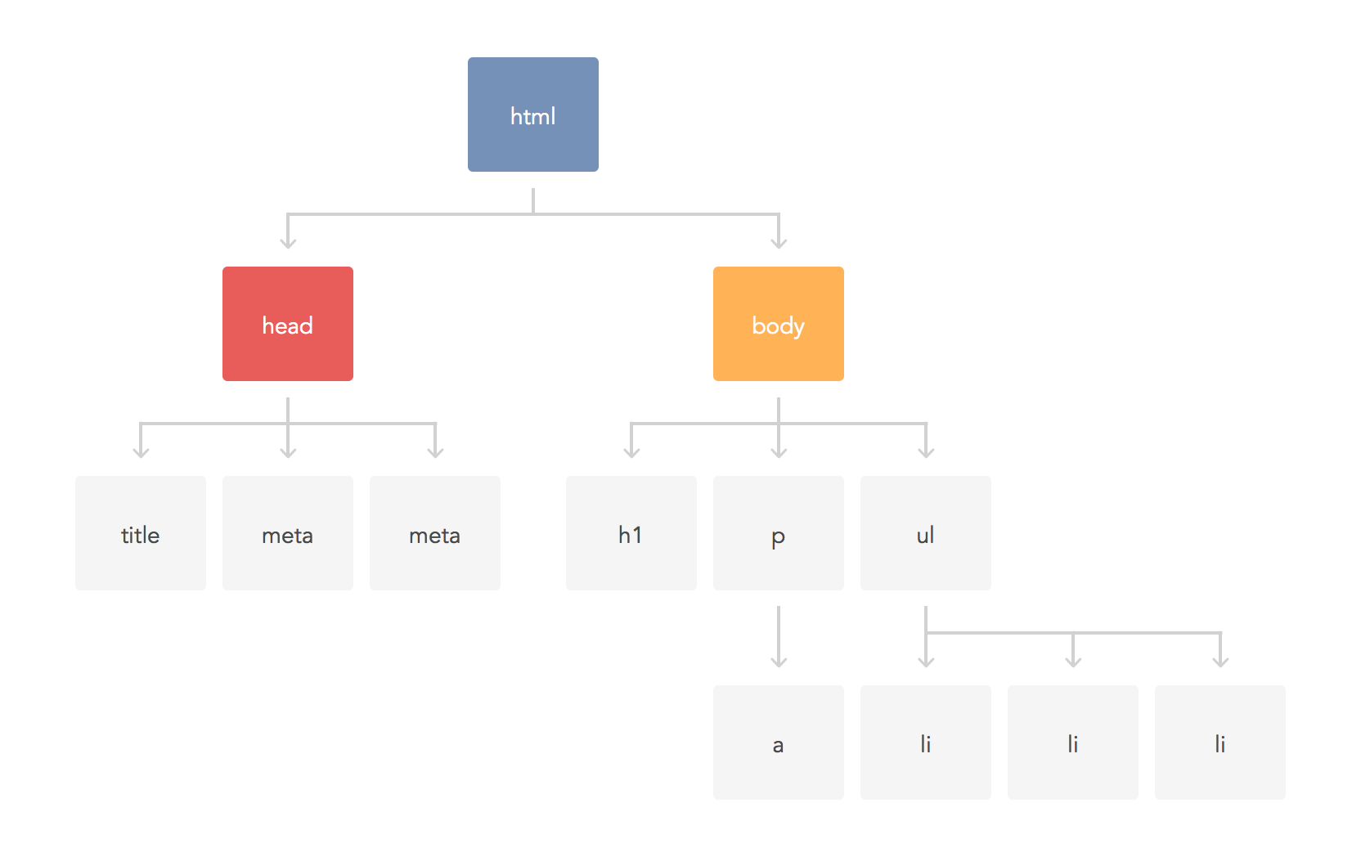

Slide 21
What’s Virtual DOM?
React didn’t invent Virtual DOM but does use it.
Its role is simply to help us work on a copy (in-memory) of the real DOM with less complications and gives better performance.
Btw, it’s all managed by React.

Slide 22
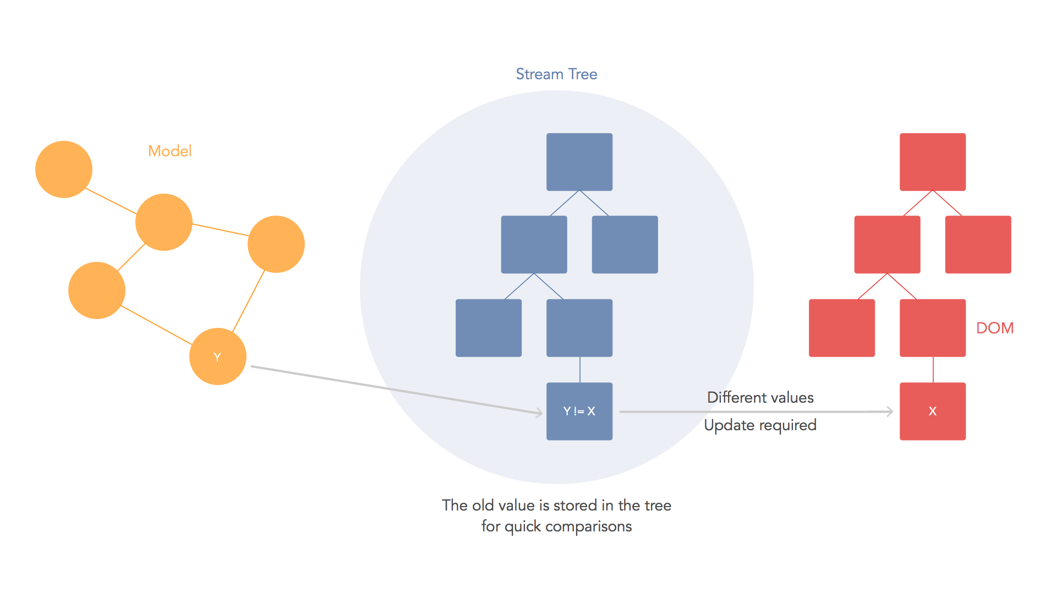

Slide 24
But… Why?

Slide 25
The era of SPA
Modern web apps built following the idea of “Single Page Application”, also known as, SPA.
It’s hard to manage the UI updates manually (due to time-consuming + bug risky)
It’s inefficient (you’ll get yourself lost over the time)

Slide 26
Do you have more Questions?
Thank you

